Slide 1


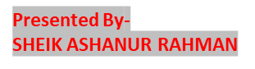
Preparing a analytics report by capturing live limited data from a reputed retail website that include relevant information of the consumer behavior through website engagement for multiple product purchase.
Project: 3&4.
Consumer Behaviour.
Mentor: Minakshi Gautam.
Organization: OESON Private Ltd.

Slide 2

PROBLEM STATEMENT:
PROJECT AGENDA:
I have given the limited data from a reputed retail website that include relevant information of the consumer behavior through website engagement for multiple product purchase.
I have to perform detail EDA on the data and prepare a prediction model which predicts whether a consumer will purchase the product after their visit on the website.
DATA EXPLORATION, MODEL AND TOOLS:
The data has been explored by Python Coding and analysed three ways.
1. Analysis Libraries: there are so many powerful libraries in Python like NumPy, SciPy, Pandas and so on. These help to provide data structures and functions for efficiently manipulating and analysing data.
2. Data Visualization: Matplotlib and Seaborn libraries help to create a wide range of static and interactive visualizations. Visualizations help in understanding patterns, trends, and relationships within the data
3. Data model: Decision Tree Classifier, Random Forest Classifier, SVM Classifier, Naïve Bayes classifier, and Gradient Boosting Classifier have done for find best accuracy of the right model.

Slide 3

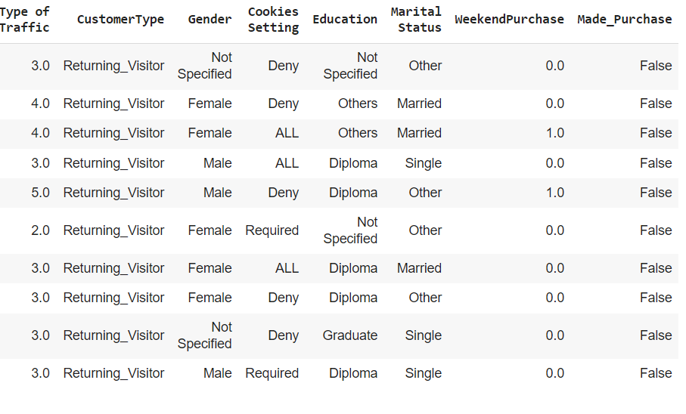
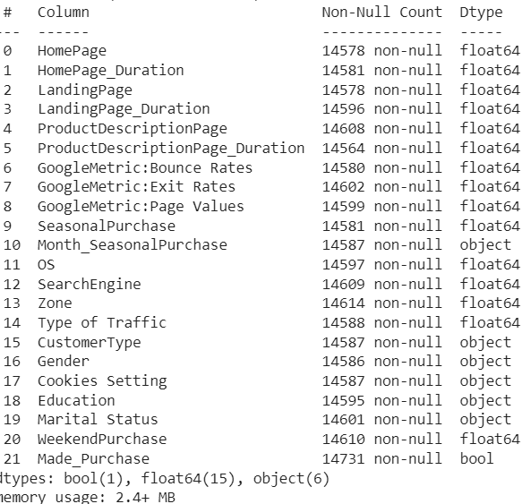
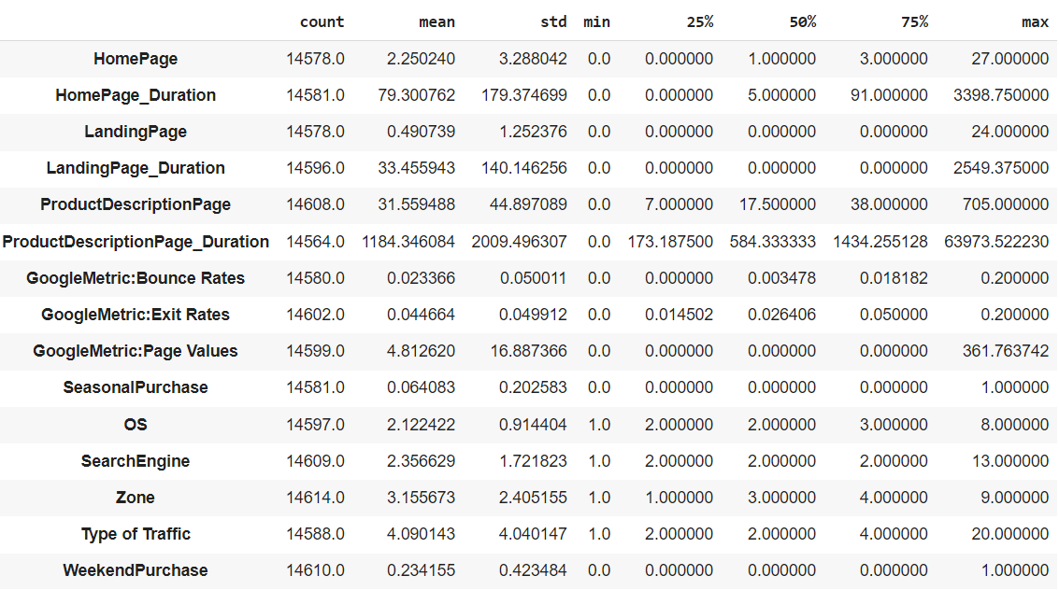
SAMPLE OF COUSTOMER DATA
DATA INFORMATION
DESCRITIVE STATISTICES
The above data is the customer behaviour from a retail website. It has 22 columns and 14731 rows with missing values. It has float, object and Boolean type data. In the right hand, its descriptive statistics is shown.

Slide 4
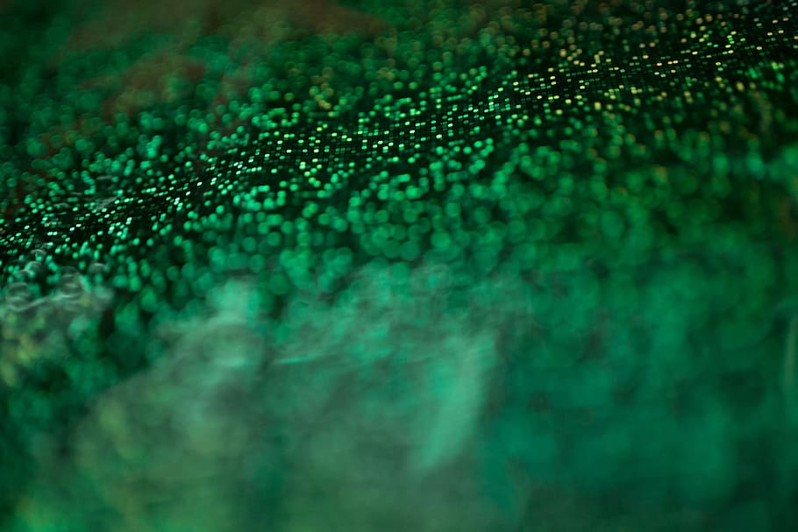
EDA:
EXPLORATORY DATA ANALYSIS.
The EDA has been performed on different tasks base on-
1. Finding high correlation by heatmap and remove them.
2. Making normal distribution by logarithm and encoding.
3. Filling null value with mean and mode method.
4. Splitting data as train and test set for algorithm.

Slide 5

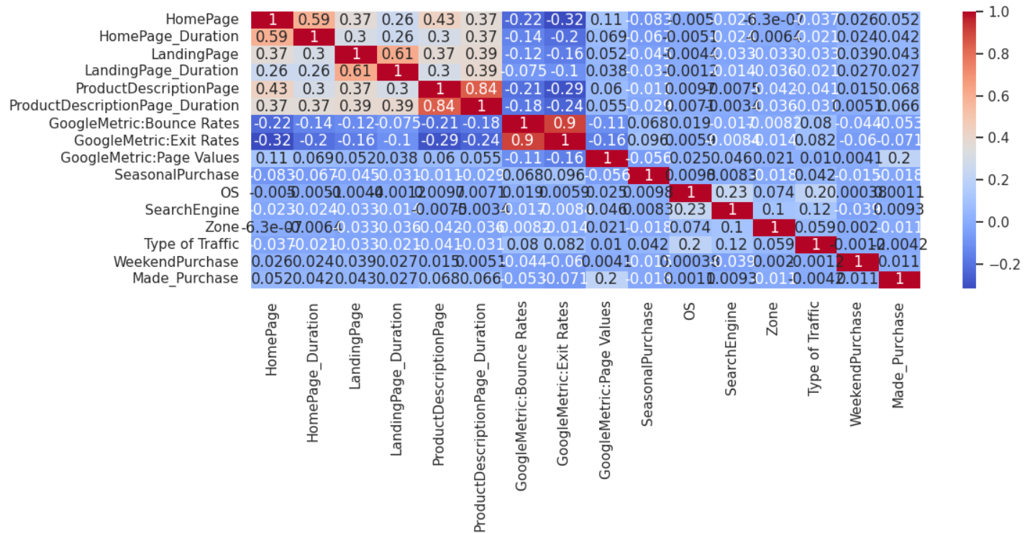
HEATMAP WITH CORELATION MATRIX:
We can see from the above heatmap of correlation matrix, 'ProductDescriptionPage_Duration' and 'ProductDescriptionPage' and also 'GoogleMetric:Bounce Rates' and 'GoogleMetric:Exit Rates' We will drop one of each grope. Because they are highly corelated( 0.84 or above) with others. As a result, columns have get drown from 22 to 20.

Slide 6

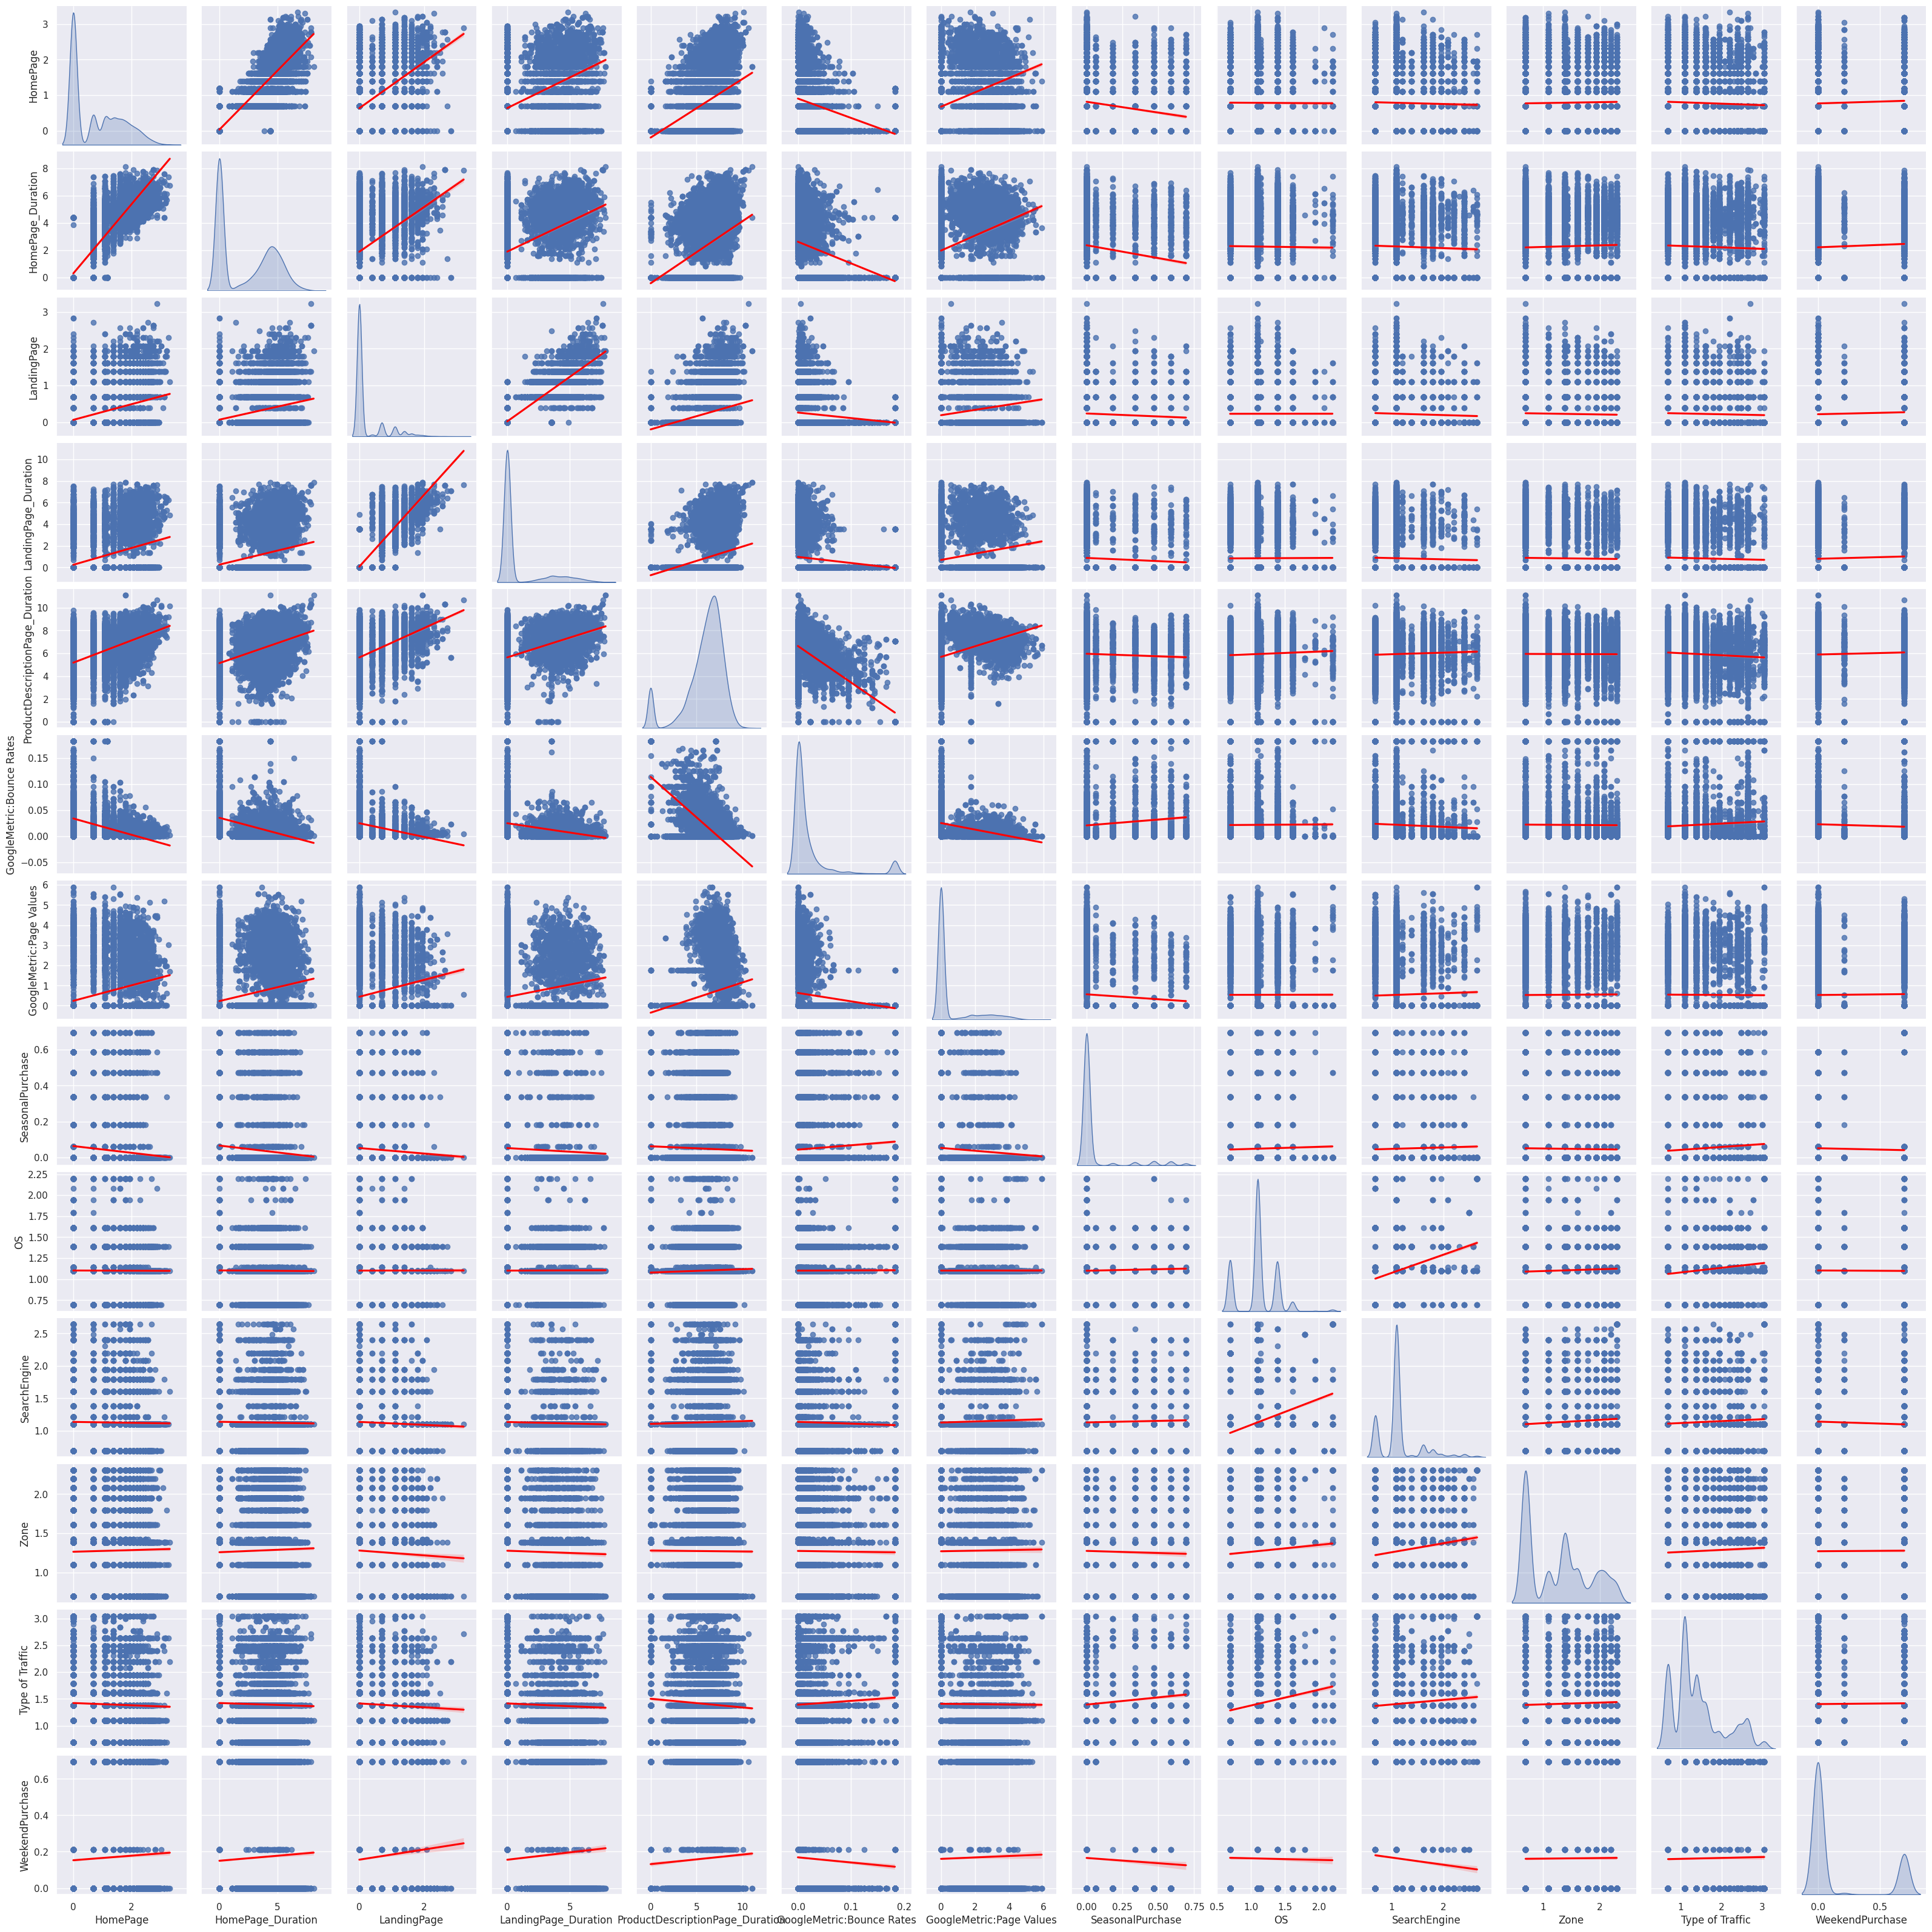
NUMERICAL PAIRPLOT:
The above pair plot of correlation with regression line show how the relation are each other and also histogram as well. We already find the high corelated data from heatmap. Here is showing rest of numerical data visualization without two high corelated.

Slide 7

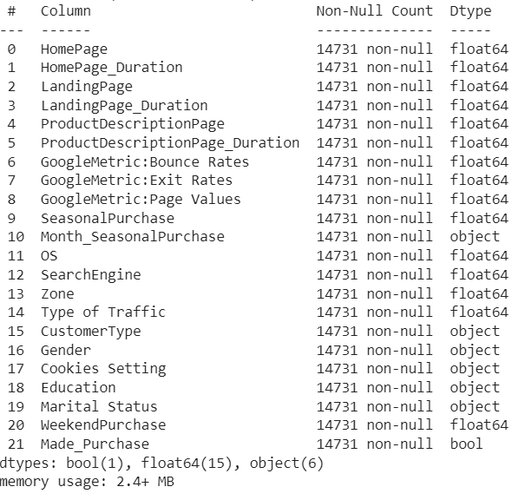
MISSING VALUES TREATMENT:
The data set has some missing values in the different rows and columns. So, we can’t drop these rows and columns due to make small data set that would loss so many information for correct outcomes. So, we have filled these missing values with mean for float and mode for object types data. As a result, we get rows as total 1431 instant of different numbers.

Slide 8

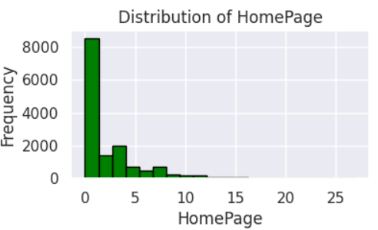
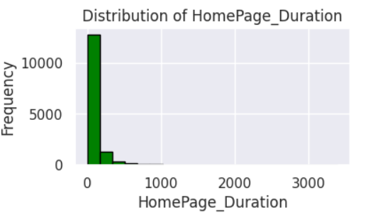
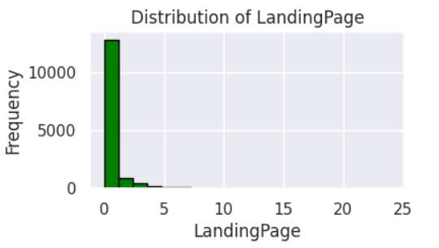
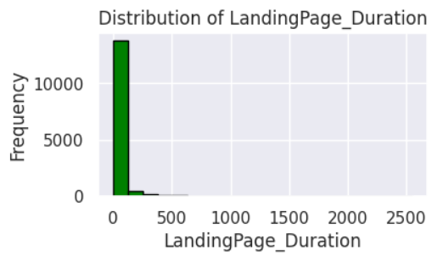
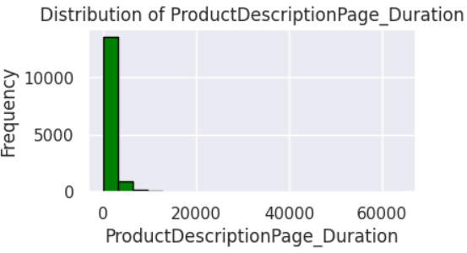
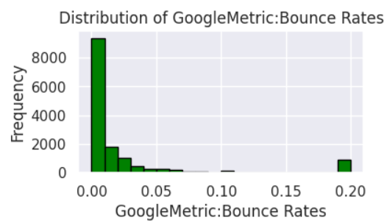
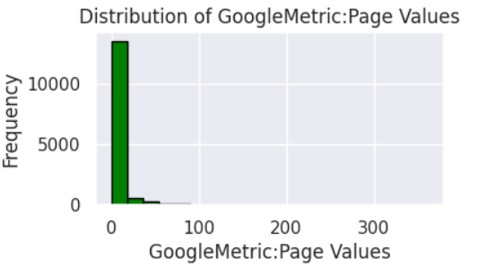
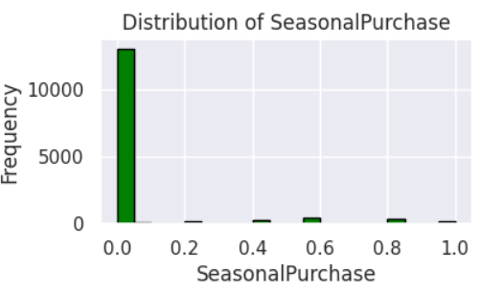
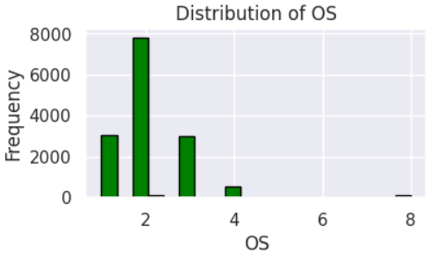
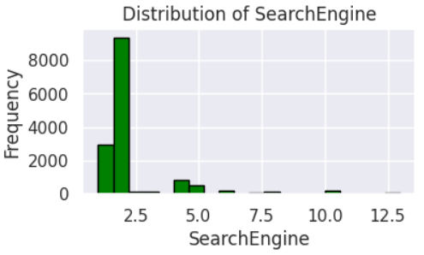
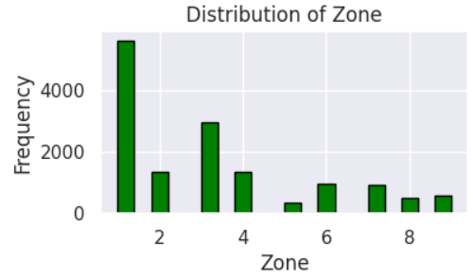
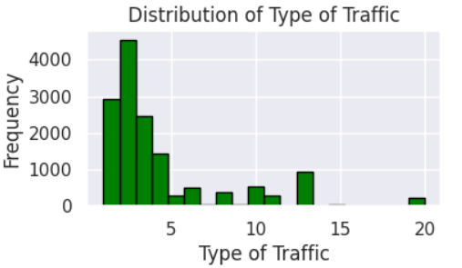
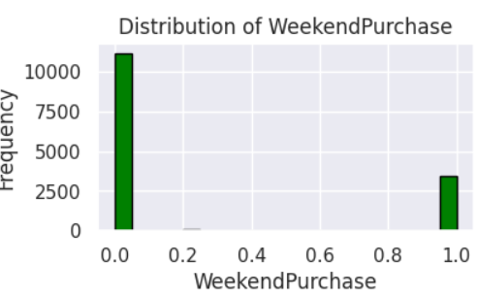
The above are numerical data visualization through histogram which are show high right skews. These have been reduced by log transformation.

Slide 9

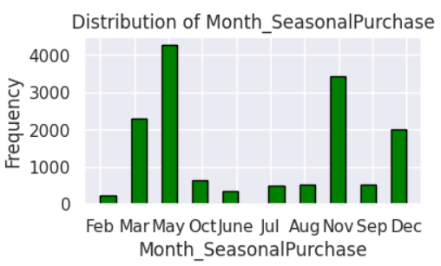
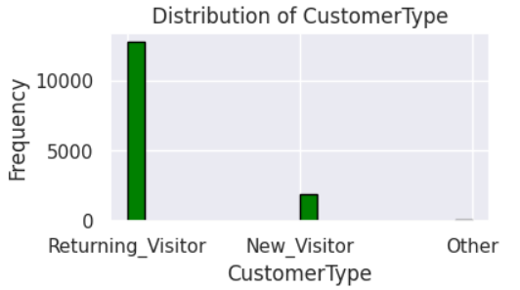
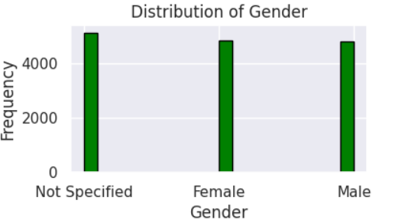
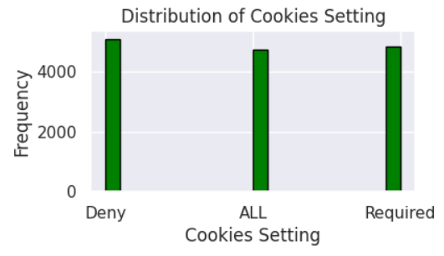
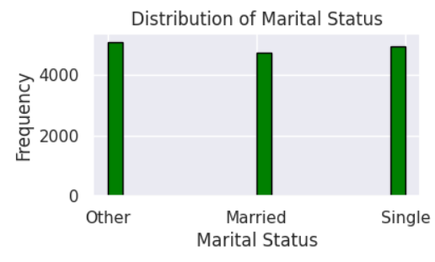
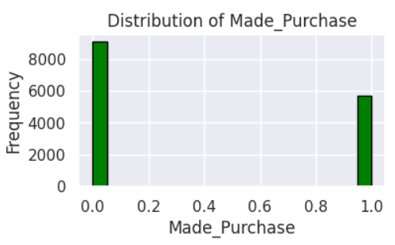
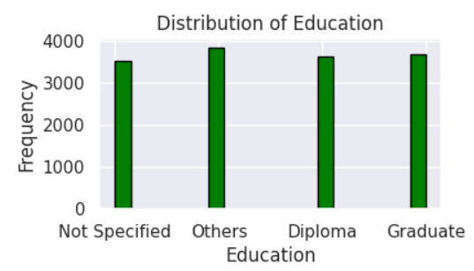
The above 6 category data has encoded and the data ‘Made Purchase’ has been transformed as int (0 or 1) before applying algorithm. Then spilt data as train and test for model.

Slide 10

MLA:
MACHINE LEARNING ALGORITHMS.
The MLA has been performed on different algorithms or models base on-
1. The accuracy of positive prediction is measured on precision.
2. Recall is the proportion of correctly predicated actual positives.
3. The accuracy is the overall accuracy of the classifier.
4. F1-score is the harmonic mean of precision and recall.

Slide 11
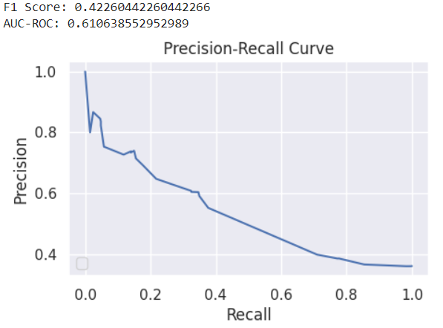
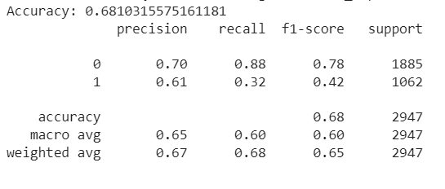
1. DECISION TREE CLASSIFIER:
We can see from the above the accuracy of the model is 0.681, the area under the ROC is 0.611 and F1 score is 0.423.

Slide 12

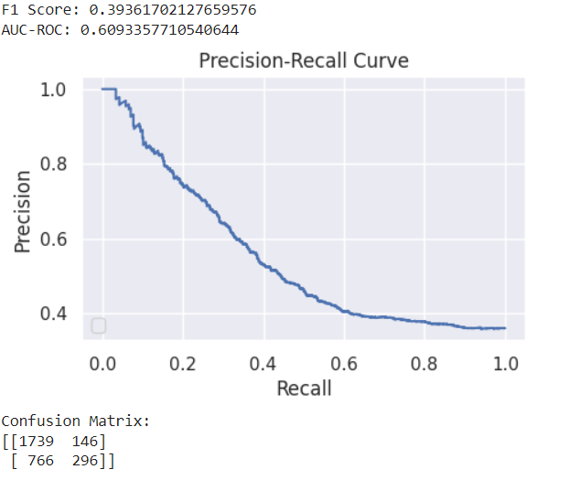
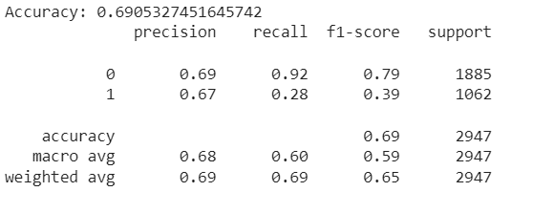
2. RANDOM FROEST CLASSIFIER:
We can see from the above the accuracy of the model is 0.691, the area under the ROC is 0.609 and F1 score is 0.393.

Slide 13

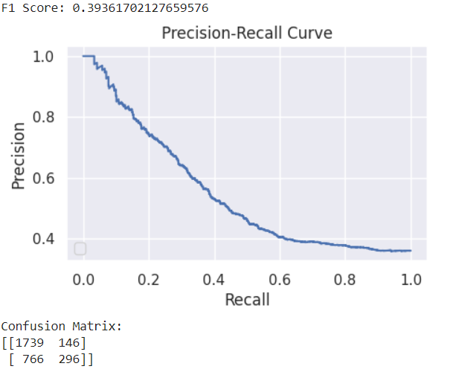
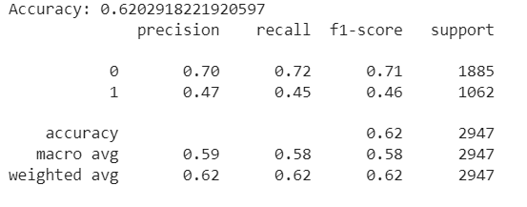
3. NAÏVE BAYES CLASSIFIER:
We can see from the above the accuracy of the model is 0.620 and F1 score is 0.394.

Slide 14

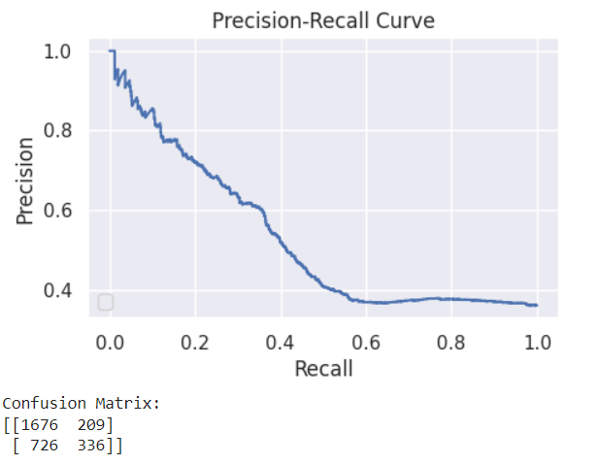
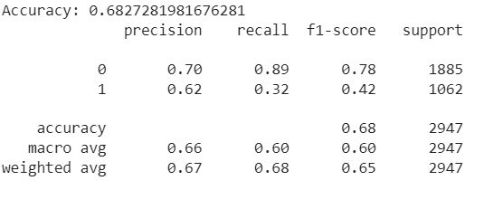
4. SVM CLASSIFIER:
We can see from the above the accuracy of the model is 0.683, the area under the ROC is 0.591 and F1 score is 0.418.

Slide 15
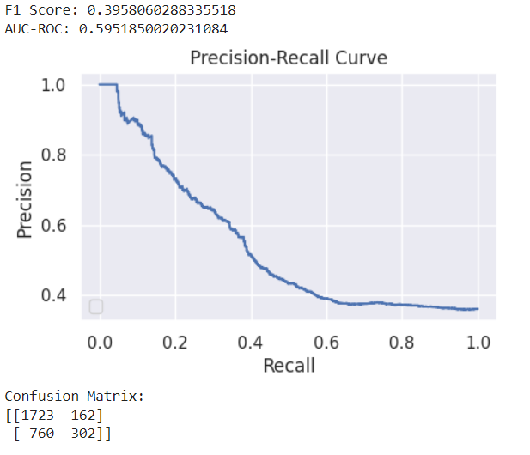
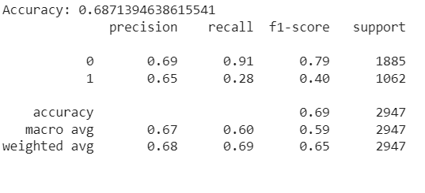
5. GRADIENT BOOSTING CLASSIFIER:
We can see from the above the accuracy of the model is 0.687, the area under the ROC is 0.595 and F1 score is 0.396.

Slide 16

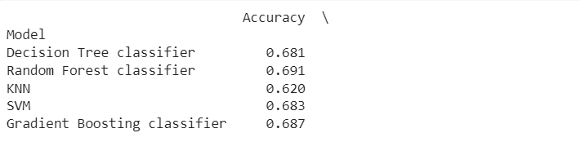
COMBINE REPORT OF ALL MODELS AND THEIR RESULTS WITH BEST:
We can see from the above chart that ‘Random Forest Classifier’ is the highest accuracy 0.691 and also very close ‘Decision tree classifier’ is 0.681, ‘SVM’ is 0.63 and ‘Gradient Boosting Classifier’ is 0.687 on the train data set which are indicating a through of understanding of perfect data set. These are prediction model which predicts whether a consumer will purchase the product after their visit on the website. So, potential overfitting is suggesting to lower test set which is ‘KNN 0.620.

Slide 17


Slide 18

CONCLUSION WITH CONSUMER BEHAVIOUR OUTCOMES:

